Slide 1
CONTACTLESS CALLING BELL
PRESENTED By :
PRADEEP KUMAR PATEL T {22AI034}
PRASAD R S {22AI037}
TAMILMANI E {22AI053}
Guided By :
MRS.LALITHA K
TEAM NO 24
22AIP10 & INTERNET OF THINGS LABORATORY

Slide 2
Abstract
This project utilizes an ultrasonic sensor and a GSM module to detect objects within a predefined distance threshold and notify a user by making an automated phone call.
The system is designed for applications such as security alarms, obstacle detection, or proximity alerts.
When an object is detected closer than the threshold distance, the system triggers a buzzer and simultaneously calls the specified phone number using the GSM module.
The setup demonstrates a simple yet effective approach to real-time object detection and alerting.

Slide 3
Objectives:
To design and implement a system that detects objects within a defined range.
To integrate a GSM module for making automated phone calls upon object detection.
To provide a cost-effective and efficient solution for proximity alert systems.
To demonstrate the practical application of ultrasonic sensors and GSM modules in security and monitoring systems.

Slide 4
Components Required:
Ultrasonic Sensor (HC-SR04)
GSM Module (SIM800)
Arduino Board
Buzzer
Connecting Wires
Resistors
Power Supply
Breadboard
Software Requirements: Arduino IDE for programming the microcontroller.

Slide 5
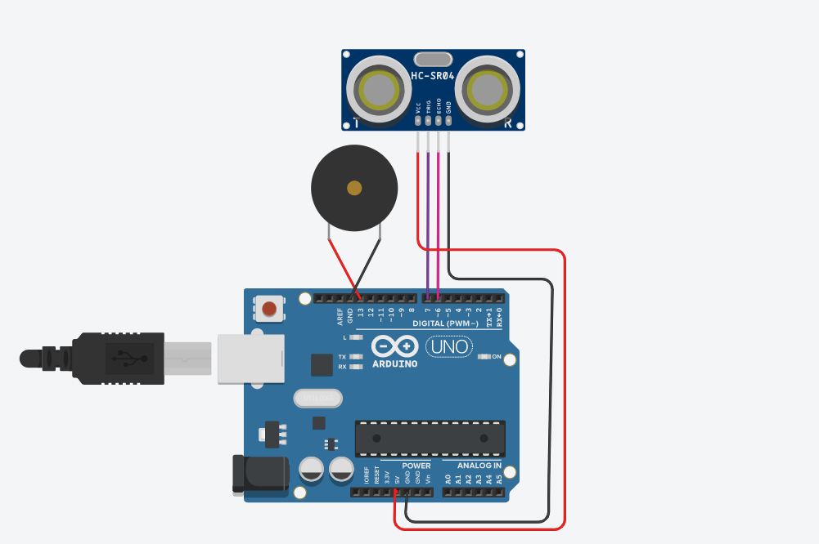
Flow Diagram:

Slide 6
Implementation: (Hardware or software)
Hardware Setup:
Connect the ultrasonic sensor's Trig and Echo pins to the Arduino's digital pins.
Attach the GSM module to the Arduino using SoftwareSerial pins (10 and 11).
Connect the buzzer to a digital pin on the Arduino.
Ensure proper power connections for all components.
Software Implementation:
Write a program in Arduino IDE to:
Measure distance using the ultrasonic sensor.
Trigger the buzzer if the distance is below the threshold.
Send AT commands to the GSM module for making calls.
Upload the program to the Arduino board.
Testing:
Power the system and observe the distance measurements displayed on the Serial Monitor.
Verify that the buzzer sounds and a call is made when an object is within the defined range.
Optimization:
Fine-tune the distance threshold as per the application requirements.
Ensure robust connections to prevent malfunctions.

Slide 7
Thank you

